Slide 1
NBA Project Team
Jorg Doku, Charles Lai, Nikita Dubnov, Nimit Sohoni, Yen Huang, Alvin Zhu, Jason Liao, Young Chan Kim

Slide 2
What’s new?
After a few weeks of going through research, we discovered a few important things.
Weighting recent games more than older games provides little to no improvement in future predictions.
Sports Prediction has a LOT of variables (player wellness, coaching patterns, etc)!

Slide 3
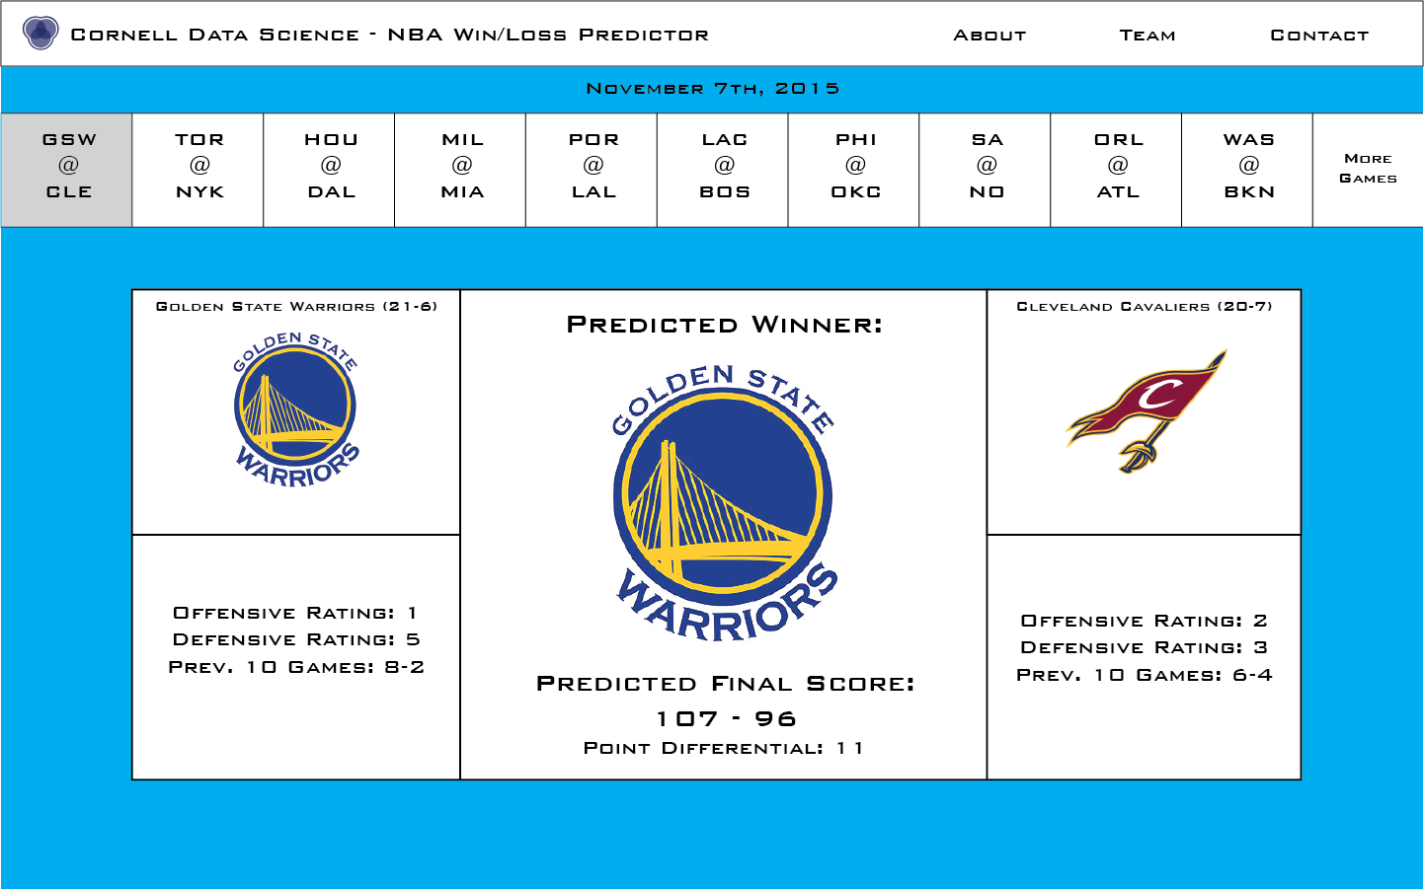
Our Current Front End Design
1)Pulls future matches off of ESPN.com
2)Runs them on our ensemble ML algorithm.
3)Displays the predictions on the page.

Slide 4
How we’re Making Predictions
Training on all the NBA data takes a very long time. Right now we’re working with the most recent years (2008-2015) for model development (later train on all with Amazon EC2).
Our model has 3 key steps:
1.Generates predicted features for a team using the rolling averages.
2.For every NBA match, we take the two team’s predicted features (X variable) and let the Y variable denote whether the former or the latter team won.

Slide 5
How we’re Making Predictions
Example of 1 row in our Training Data)
GoldenState’s rolling average up to November 7th is “85.3,20.5,.78,...”
Miami Heat’s is “73.7,25.5,.84,...”
Assume GoldenState beat Miami Heat on November 7th.
We’d have this row in our training Data.
PtsA,ReboundsA,WinsA,...,PtsB,ReboundsB,WinsB,formerTeamWin?
85.3,20.5,.78,...,73.7,25.5,.84,...,1

Slide 6
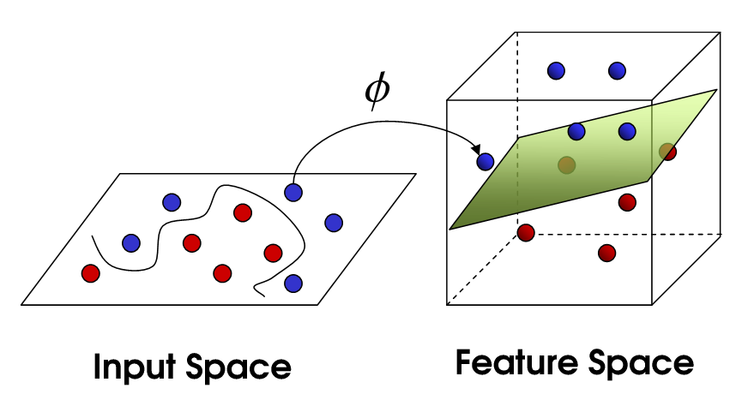
How we’re Making Predictions
Now that we’ve developed the features (X) and targets (Y),
we feed our data into a Support Vector Machine with a Gaussian Kernel. This gives us something like the picture below.
(except the separating
hyperplane would be
higher dimensional).

Slide 7
What we’re working on from here
Taking into account player injuries.
Let the web app scrape ESPN.com and check if a player if injured. If so, update the predictions accordingly.
Taking into account starting players.
Same idea as above.
Taking into account Twitter Hashtags (Just for fun)
Same idea as above.

Slide 8
What we’re curious about
Play by play data.
X,Y Shot + Player Location data.
Really curious how we could use of the data above.

Slide 9
Thank You
CDS is Da Bomb!

